Slide 1
Chapter 12 Simple Regression
Copyright © 2022 McGraw Hill. All rights reserved. No reproduction or distribution without the prior written consent of McGraw Hill.
1-1

Slide 2
Chapter Learning Objectives
Chapter 12
LO12-1: Calculate and test a correlation coefficient for significance.
LO12-2: Interpret a regression equation and use it to make predictions.
LO12-3: Explain the form and assumptions of a simple regression model.
LO12-4: Explain the least squares method, apply formulas for coefficients, and interpret R².
LO12-5: Construct confidence intervals and test hypotheses for the slope and intercept.
LO12-6: Interpret the ANOVA table and use it to compute F, R², and standard error.
LO12-7: Distinguish between confidence and prediction intervals for Y.
LO12-8: Calculate residuals and perform tests of regression assumptions.
LO12-9: Identify unusual residuals and tell when they are outliers.
LO12-10: Define leverage and identify high-leverage observations.
LO12-11: Improve data conditioning and use transformations if needed (optional).
LO12-12: Identify when logistic regression is appropriate and calculate predictions for a binary response variable.

Slide 3
Simple Regression
Chapter 12
Understanding how different variables in our business processes are related to each other helps us predict and, hopefully, improve our business performance.
Examples of quantitative variables that might be related to each other include spending on advertising and sales revenue, produce delivery time and percentage of spoiled produce, premium and regular gas prices, and preventive maintenance spending and manufacturing productivity rates.

Slide 4
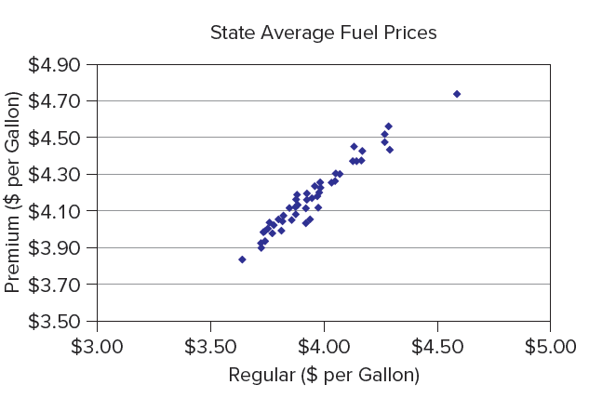
Visual Displays
LO 12-1
Begin the analysis of bivariate data (i.e., two variables) with a scatter plot.
A scatter plot
Displays each observed data pair (x_{i}, y_{i}) as a dot on an X-Y grid.
Indicates visually the strength of the relationship or association between the two variables.
A scatter plot is typically the precursor to more complex analytical techniques.

Slide 5
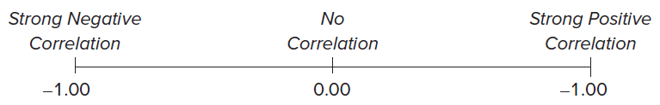
Correlation Coefficient
LO 12-1
The sample correlation coefficient measures the degree of linearity in the relationship between two random variables X and Y and is denoted r.
Its value will fall in the interval [-1, 1]
When r is near 0, there is little or no linear relationship between X and Y. An r-value near +1 indicates a strong positive relationship, while an r-value near −1 indicates a strong negative relationship.

Slide 6
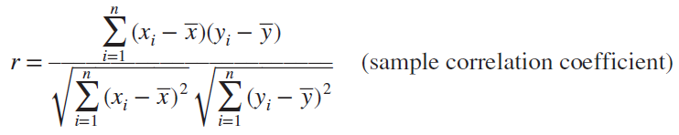
Correlation Coefficient
LO 12-1
Sample correlation coefficient formula
If r = 0 then that indicates no linear relationship

Slide 7

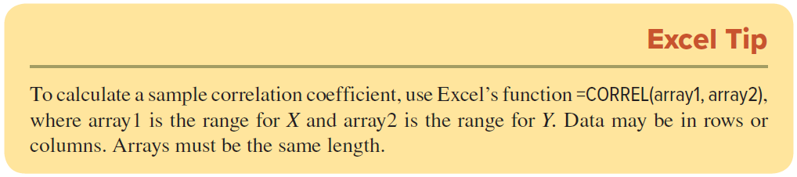
Correlation Coefficient
12-1
To simplify the notation here and elsewhere in this chapter, we define three terms called sums of squares:
Using this notation, the formula for the sample correlation coefficient can be written

Slide 8
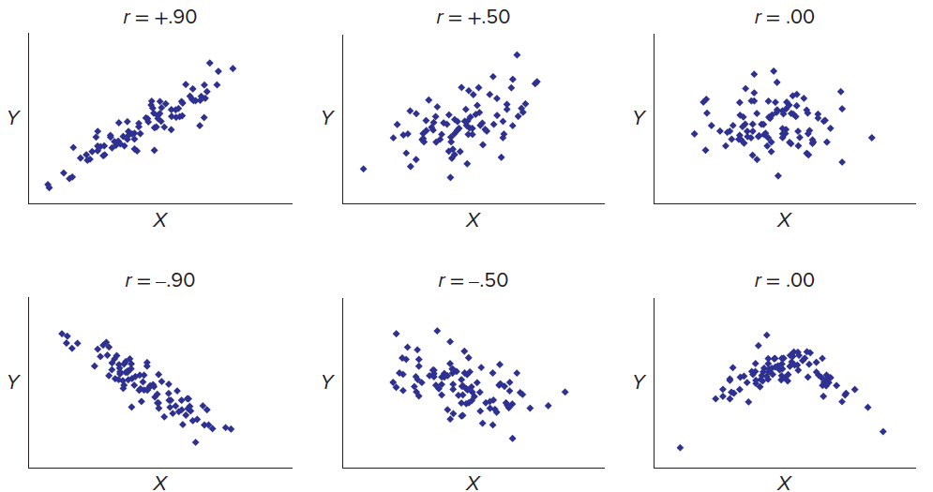
Correlation Coefficient
12-1
Scatter Plots Showing Various Correlation Coefficient Values (n = 100)

Slide 9

Test for Significant Correlation
LO 12-1
The sample correlation coefficient r is an estimate of the population correlation coefficient ρ (the Greek letter rho). There is no flat rule for a “high” correlation because sample size must be taken into consideration. To test the hypothesis H₀: ρ = 0, the test statistic is
We compare this t test statistic with a critical value of t for a one-tailed or two-tailed test from Appendix D using d.f. = n − 2 degrees of freedom and any desired α.
After calculating the t statistic, we can find its p-value by using Excel’s function =T.DIST.2T(t, deg_freedom).

Slide 10
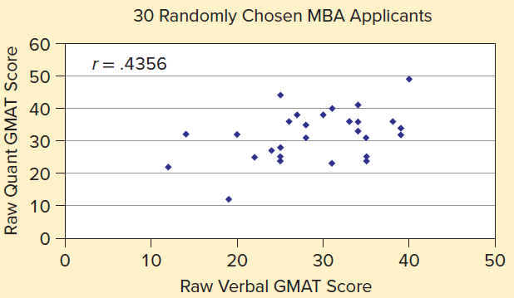
Example: MBA Applicants
12-1
In its admission decision process, a university’s MBA program examines an applicant’s score on the Graduate Management Aptitude Test (GMAT), which has both verbal and quantitative components. Figure 12.4 shows the scatter plot with the sample correlation coefficient for 30 MBA applicants randomly chosen from 1,961 MBA applicant records at a public university in the Midwest. Is the correlation (r = .4356) between verbal and quantitative GMAT scores statistically significant? It is not clear from the scatter plot shown that there is a statistically significant linear relationship.

Slide 11

Example: MBA Applicants
12-1
Step 1: State the Hypotheses
We will use a two-tailed test for significance at α = .05. The hypotheses are
Step 2: Specify the Decision Rule
For a two-tailed test using d. f. = n − 2 = 30 − 2 = 28 degrees of freedom, Appendix D gives t_{.025} = 2.048. The decision rule is

Slide 12

Example: MBA Applicants
12-1
Step 3: Calculate the Test Statistic
To calculate the test statistic, we first need to calculate the value for r. Using Excel’s function =CORREL(array1, array2), we find r = .4356 for the variables Quant GMAT and Verbal GMAT. We must then calculate t_{calc}.

Slide 13
Example: MBA Applicants
12-1
Step 4: Make a Decision
The test statistic value (t_{calc} = 2.561) exceeds the critical value t_{.025} = 2.048, so we reject the hypothesis of zero correlation at α = .05. We also can find the p-value using the Excel function =T.DIST.2T(t, deg_freedom). The two-tailed p-value for GMAT score is =T.DIST.2T(2.561,28) = .0161. We would reject ρ = 0 because the p-value < .05.
Step 5: Take Action
The admissions officers recognize that these scores tend to vary together for applicants.

Slide 14
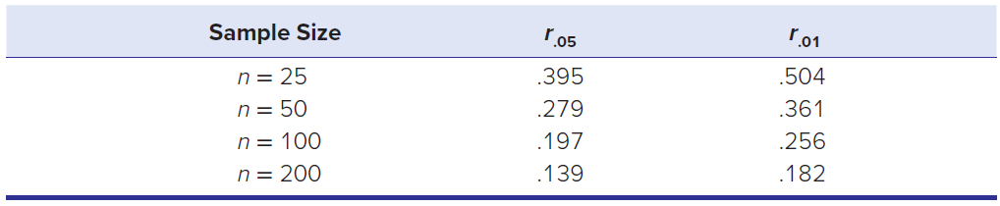
Correlation Coefficient
LO 12-1
The table shows that, as sample size increases, the critical value of r becomes smaller. Thus, in very large samples, even very small correlations could be “significant.” In a larger sample, smaller values of the sample correlation coefficient can be considered “significant.”

Slide 15
Simple Regression
LO 12-2
Simple Regression analyzes the relationship between two variables.
Regression is used to mathematically model these relationships for prediction purposes.
Business examples include:
Advertising expenditures predict quarterly sales revenue.
Number of dependents predicts employee prescription drug expenses.
Apartment size predicts monthly rent.
Engine horsepower predicts miles per gallon.

Slide 16
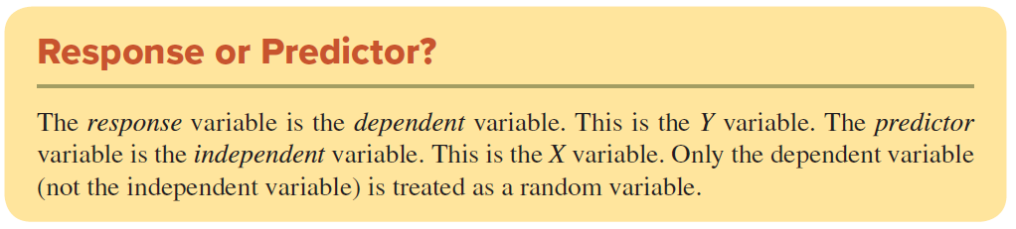
Simple Regression
LO 12-2
Simple Regression specifies one dependent (response) variable and one independent (predictor) variable.
The hypothesized relationship here will be linear of the form Y = slope x X + y-intercept.

Slide 17
Simple Regression
LO 12-2
The intercept and slope of an estimated regression can provide useful information.
The slope tells us how much, and in which direction, the response variable will change for each one unit increase in the explanatory variable.
However, it is important to interpret the intercept with caution because it is meaningful only if the explanatory variable would reasonably have a value equal to zero.

Slide 18
Regression Examples
LO 12-2
Sales = 268 + 7.37 Ads | Each extra $1 million of advertising will generate $7.37 million of sales on average. The firm would average $268 million of sales with zero advertising. However, the intercept may not be meaningful because Ads = 0 may be outside the range of observed data.
DrugCost = 410 + 550 Dependents | Each extra dependent raises the mean annual prescription drug cost by $550. An employee with zero dependents averages $410 in prescription drugs.
Rent = 150 + 1.05 SqFt | Each extra square foot adds $1.05 to monthly apartment rent. The intercept is not meaningful because no apartment can have SqFt = 0.
MPG = 49.22 − 0.079 Horsepower | Each unit increase in engine horsepower decreases the fuel efficiency by 0.079 mile per gallon. The intercept is not meaningful because a zero horsepower engine does not exist.

Slide 19
Simple Regression
LO 12-2
Consider a regression equation with unemployment rate per capita as the explanatory variable and crime rate per capita as the response variable.
Crime Rate = 0.125 + 0.031 Unemployment Rate
The slope value, 0.031, means that for each one unit increase in the unemployment rate, we expect to see an increase of .031 in the crime rate. Does this mean being out of work causes crime to increase?
No, there are many lurking variables that could further explain the change in crime rates (e.g., poverty rate, education level, or police presence).

Slide 20
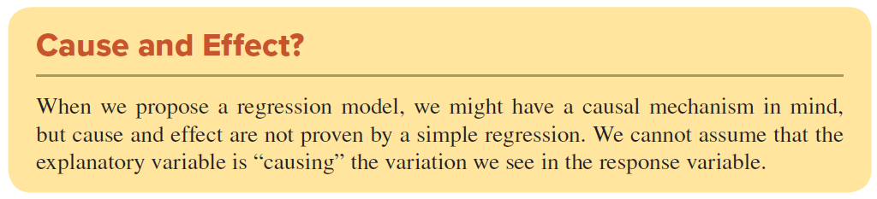
Simple Regression
LO 12-2

Slide 21
Prediction Using Regression
LO 12-2
One of the main uses of regression is to make predictions.
Once we have a fitted regression equation that shows the estimated relationship between X (the independent variable) and Y (the dependent variable), we can plug in any value of X to obtain the prediction for Y.

Slide 22
Prediction Using Regression Examples
LO 12-2
Sales = 268 + 7.37 Ads | If the firm spends $10 million on advertising, its predicted sales would be $341.7 million; that is, Sales = 268 + 7.37(10) = 341.7.
DrugCost = 410 + 550 Dependents | If an employee has four dependents, the predicted annual drug cost would be $2,610; that is, DrugCost = 410 + 550(4) = 2,610.
Rent = 150 + 1.05 SqFt | The predicted rent on an 800-square-foot apartment is $990; that is, Rent = 150 + 1.05(800) = 990.
MPG = 49.22 − 0.079 Horsepower | If an engine has 200 horsepower, the predicted fuel efficiency is 33.42 mpg; that is, MPG = 49.22 − 0.079(200) = 33.42.

Slide 23
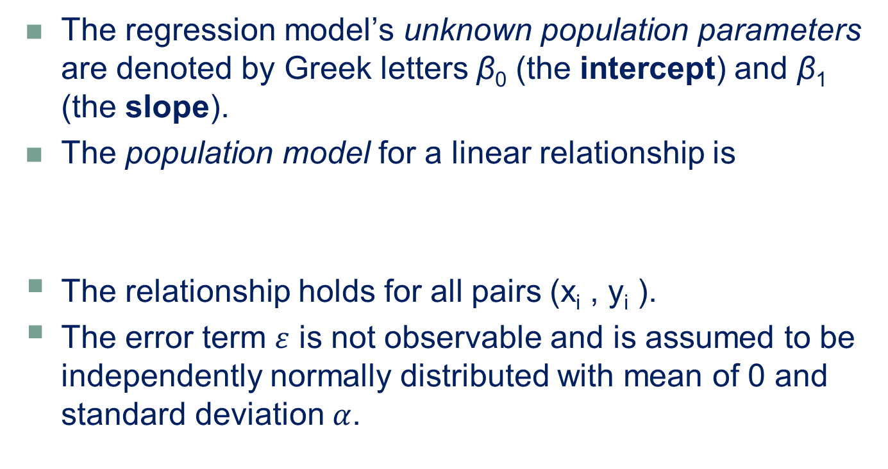
Regression Models
LO 12-3
The regression model’s unknown population parameters are denoted by Greek letters β₀ (the intercept) and β₁ (the slope).
The population model for a linear relationship is
The relationship holds for all pairs (x_{i} , y_{i} ).
The error term $ε$ is not observable and is assumed to be independently normally distributed with mean of 0 and standard deviation $α$.

Slide 24
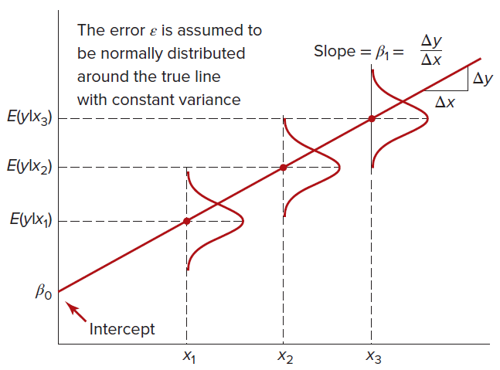
Regression Assumptions
LO 12-3
Assumptions we make when running regression are
Assumption 1: The errors are normally distributed.
Assumption 2: The errors have constant variance, σ2.
Assumption 3: The errors are independent of each other.

Slide 25

Regression Equation
12-3
From the sample, we estimate the regression equation and use it to predict the expected value of Y for a given value of X:
b₀ is the estimated intercept
b₁ is the estimated slope

Slide 26
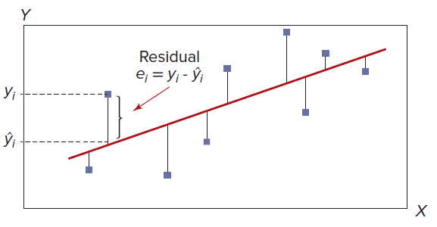

Residuals
LO 12-3
The difference between the observed value y_{i} and its estimated value $\hat{y_{i}}$ is called a residual and is denoted e_{i}.
The residual is the vertical distance between each y_{i} and the estimated regression line on a scatter plot of ( x_{i}, y_{i}) values.

Slide 27
Fitting a Regression on a Scatter Plot
LO 12-3
From a scatter plot, we could visually estimate the slope and intercept.
A more precise method is to let Excel calculate the estimates.
Step 1: Highlight the data columns.
Step 2: Click on Insert and choose Scatter to create a graph.
Step 3: Click on the scatter plot points to select the data.
Step 4: Right-click and choose Add Trendline.
Step 5: Choose Options and check Display Equation on chart.

Slide 28
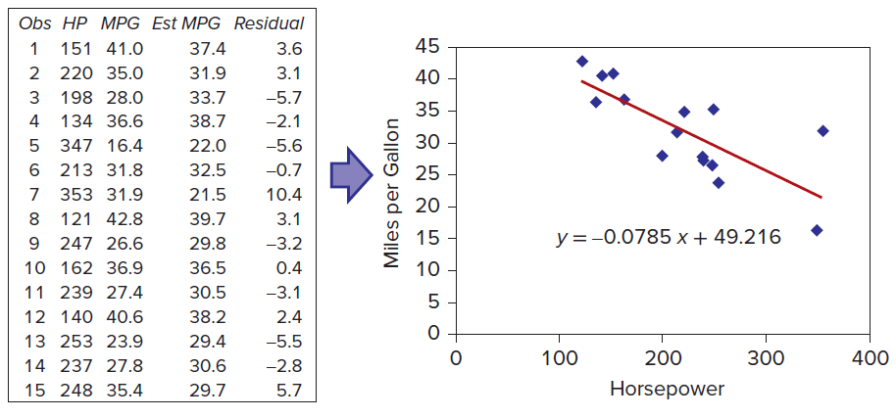
Fitting a Regression on a Scatter Plot
LO 12-3
A sample of miles per gallon and horsepower for 15 engines.

Slide 29
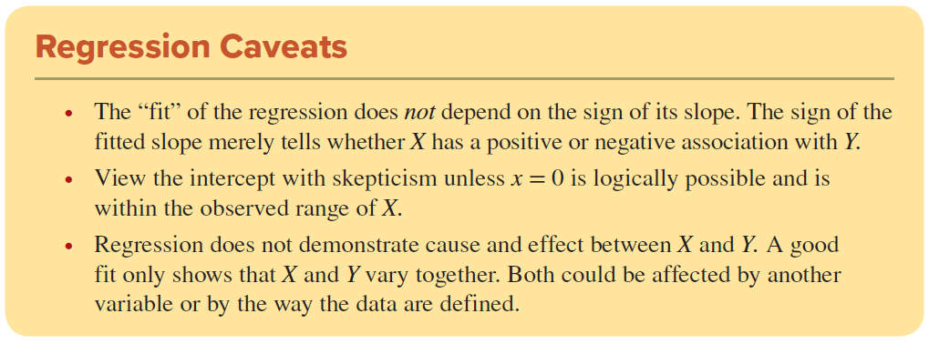
Regression
LO 12-3

Slide 30

Ordinary Least Squares Formulas
LO 12-4
The ordinary least squares method (or OLS method for short) is used to estimate a regression so as to ensure the best fit.
The sum of the residuals = 0
The sum of the squared residuals is SSE

Slide 31
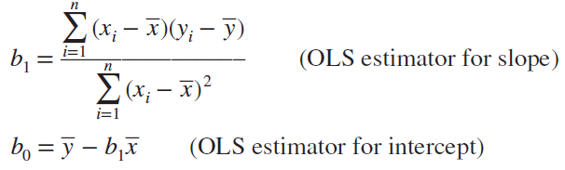

Slope and Intercept
LO 112-4
This is an optimization problem that can be solved for b₀ and b₁ by using Excel’s Solver Add-In. However, we also can use calculus to solve for b₀ and b₁.
The OLS estimator for the slope is:

Slide 32
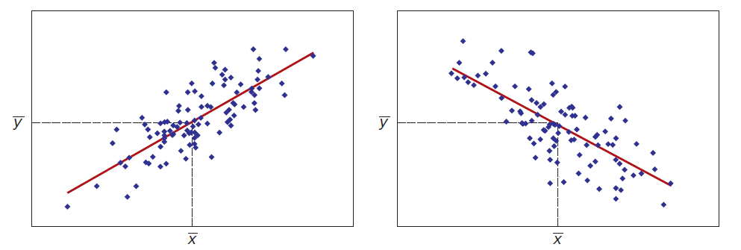
Example: Exam Scores and Study Time
LO 12-4
What is the relationship between the number of hours a student studies and his or her exam score? We can estimate the regression line for these two variables using a sample of 10 students.

Slide 33
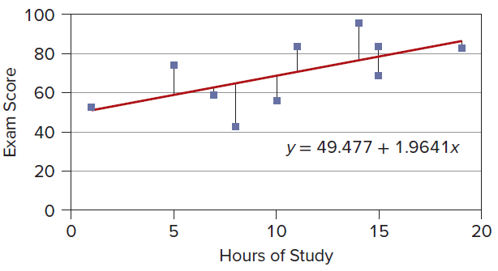
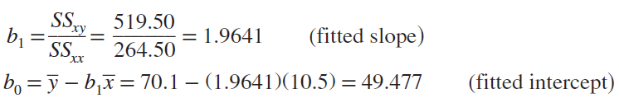
Example: Exam Scores and Study Time
LO 12-4
The fitted regression Score = 49.477 + 1.9641 Study says that, on average, each additional hour of study yields a little less than 2 additional exam points (the slope).
A student who did not study (Study = 0) would expect a score of about 49 (the intercept).

Slide 34


Sources of Variation in Y
LO 12-4
In a regression, we seek to explain the variation in the dependent variable around its mean. We express the total variation as a sum of squares (denoted SST):
We can split the total variation into two parts:

Slide 35


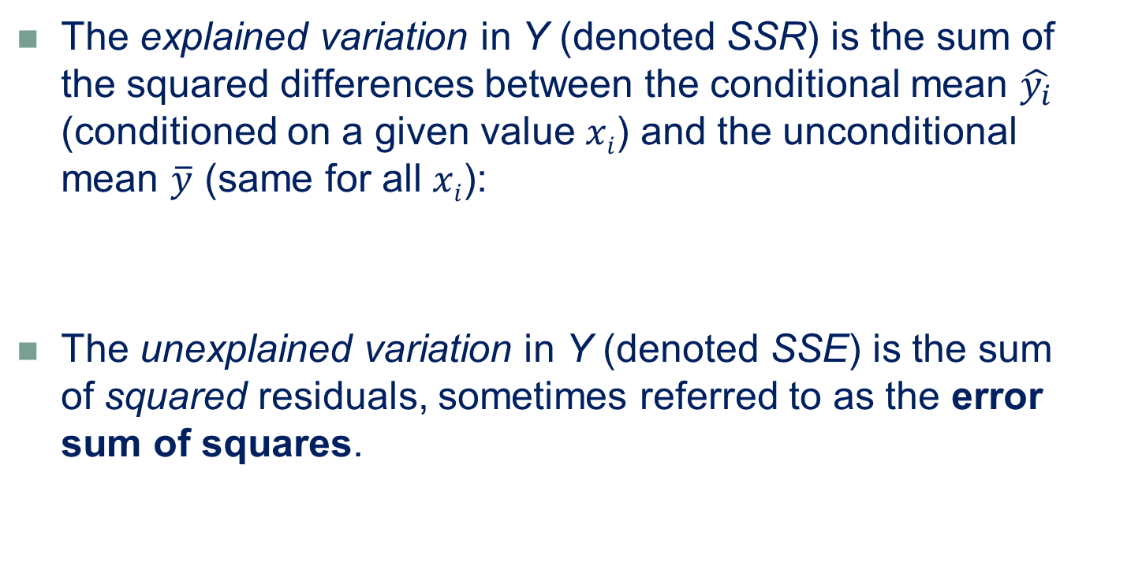
Sources of Variation in Y
LO 12-4
The explained variation in Y (denoted SSR) is the sum of the squared differences between the conditional mean $\hat{y_{i}}$ (conditioned on a given value $xi$) and the unconditional mean $\overline{y}$ (same for all $xi$):
The unexplained variation in Y (denoted SSE) is the sum of squared residuals, sometimes referred to as the error sum of squares.

Slide 36

Coefficient of Determination
LO 12-4
The coefficient of determination or R² always lies in the range 0 ≤ R² ≤ 1 , it is often expressed as a percent of variation explained.
The highest possible R2 is 1 because, if the regression gives a perfect fit, then SSE = 0
The lowest possible R2 is 0 because, if knowing the value of X does not help predict the value of Y, then SSE = SST

Slide 37
Coefficient of Determination
LO 12-4
The exam score regression yields R2 = .3941, therefore, we could say that X (hours of study) “explains” 39.41 percent of the variation in y (exam scores).
On the other hand, 60.59 percent of the variation in exam scores is not explained by study time.
The unexplained variation reflects factors not included in our model (e.g., reading skills, hours of sleep, hours of work at a job, physical health, etc.) or just plain random variation.

Slide 38
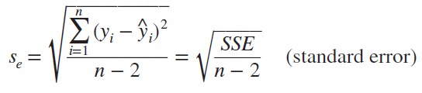
Standard Error
LO 12-5
A measure of overall fit is the standard error of the estimate, denoted s_{e}:
If the model’s predictions are perfect, then the residuals will be zero, or SSE = 0, and the standard error s_{e} will be zero.
In general, a smaller value of se indicates a better fit.

Slide 39
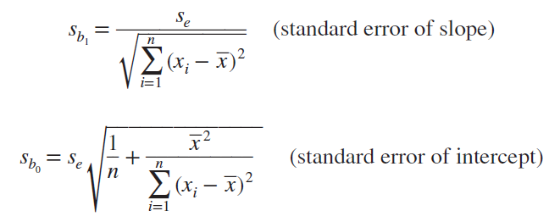
Confidence Intervals for Slope and Intercept
LO 12-5
Once we have the standard error s_{e}, we construct confidence intervals for the coefficients from the formulas shown below.

Slide 40
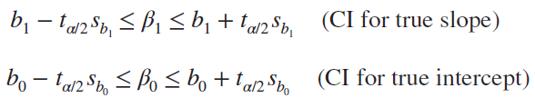
Confidence Intervals for Slope and Intercept
LO 12-5
These standard errors are used to construct confidence intervals for the true slope and intercept, using Student’s t with d.f. = n − 2 degrees of freedom and any desired confidence level.
Some software packages (e.g., Excel and MegaStat) provide confidence intervals automatically, while others do not (e.g., Minitab).

Slide 41
Hypothesis Tests
LO 12-5
Is the true slope different from zero? This is an important question because if β₁ = 0, then X is not associated with Y and the regression model collapses to a constant β₀ plus a random error term:

Slide 42
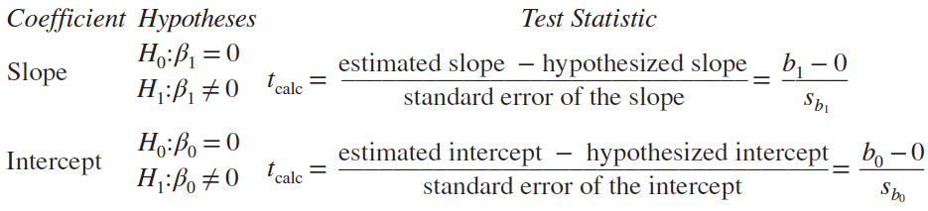
Hypothesis Tests
LO 12-5
For testing either coefficient, we use a t test with d.f. = n − 2 degrees of freedom.
Usually we are interested in testing whether the parameter is equal to zero, as shown here, but you may substitute another value in place of 0 if you wish.
The hypotheses and their test statistics are

Slide 43
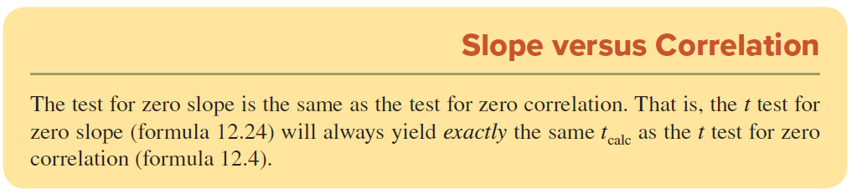
Slope versus Correlation
LO 12-5

Slide 44


Example: Exam Scores
LO 12-5
For the exam scores, we would anticipate a positive slope (i.e., more study hours should improve exam scores), so we will use a right-tailed test.
Step 1: State the Hypotheses
Step 2: Specify the Decision Rule
For a right-tailed test with α = .05 and d.f. = 10 − 2 = 8, t_{.05} = 1.860. Our decision rule states:

Slide 45

Example: Exam Scores
LO 12-5
Step 3: Calculate the Test Statistic
To calculate the test statistic, we use the slope estimate (b₁ = 1.9641) and the standard error ( s_{b1} = 0.86095 ) we calculated previously:
Step 4: Make a Decision
Because t_{calc} > t.05 (2.281 > 1.860), we can reject the hypothesis of a zero slope in a right-tailed test. (We would be unable to do so in a two-tailed test because the critical value of our t statistic would be 2.306.)

Slide 46
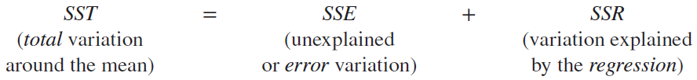
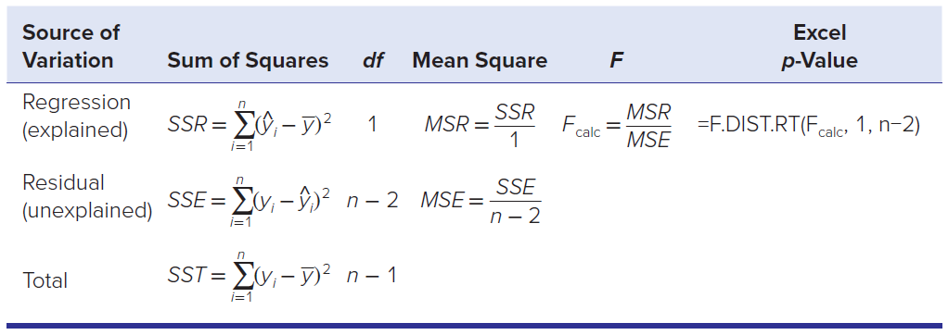
Analysis of Variance
LO 12-6
The decomposition of variance may be written as
To test a regression for overall significance, we use an F test to compare the explained (SSR) and unexplained (SSE) sums of squares. The ANOVA table below shows the calculations.

Slide 47
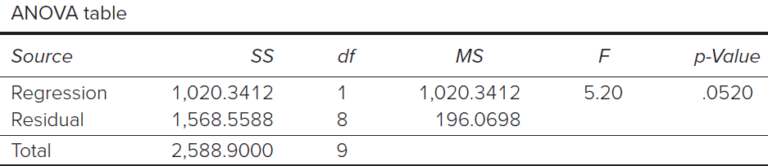

Example: Exam Scores
LO 12-6
ANOVA table for Exam Data
The F statistic is

Slide 48
Example: Exam Scores
LO 12-6
From Appendix F the critical value of F1,8 at the 5 percent level of significance would be 5.32, so the exam score regression is not quite significant at α = .05. The p-value of .052 says a sample such as ours would be expected about 52 times in 1,000 samples if X and Y were unrelated. In other words, if we reject the hypothesis of no relationship between X and Y, we face a Type I error risk of 5.2 percent. This p-value might be called marginally significant.
From the ANOVA table, we can calculate the standard error from the mean square for the residuals:

Slide 49
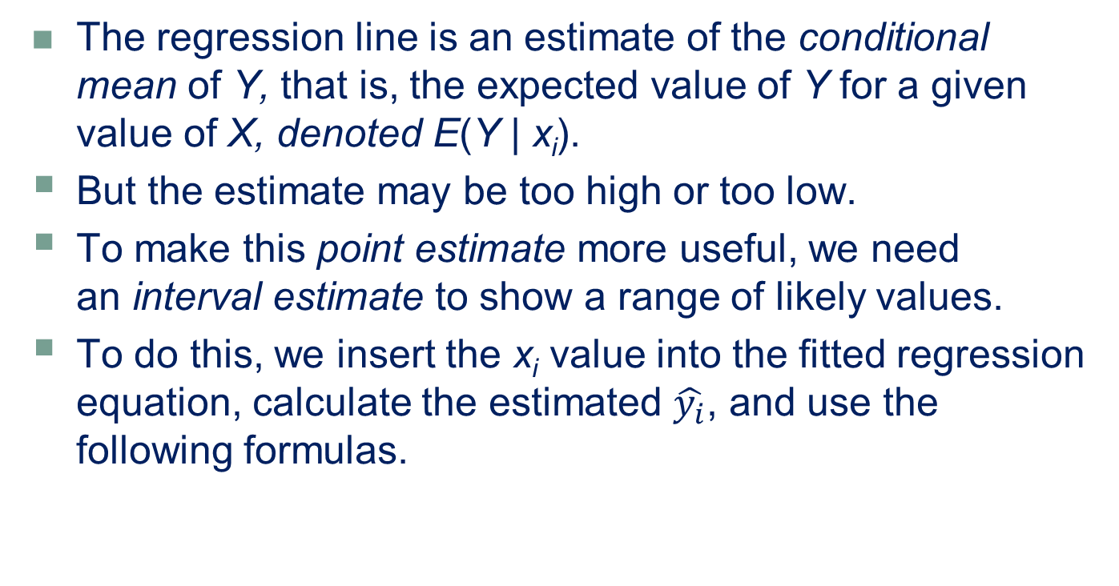
Confidence and Prediction Intervals For Y
LO 12-7
The regression line is an estimate of the conditional mean of Y, that is, the expected value of Y for a given value of X, denoted E(Y | x_{i}).
But the estimate may be too high or too low.
To make this point estimate more useful, we need an interval estimate to show a range of likely values.
To do this, we insert the x_{i} value into the fitted regression equation, calculate the estimated $\hat{y_{i}}$​​, and use the following formulas.

Slide 50
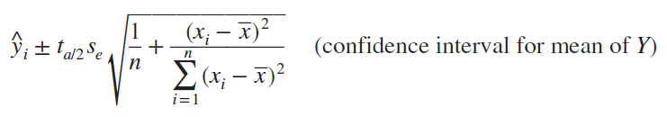
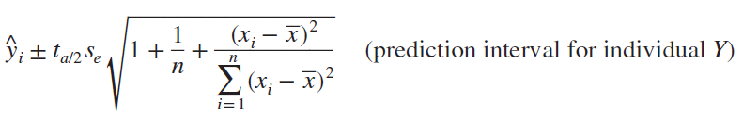
Confidence and Prediction Intervals For Y
LO 12-7
A confidence interval for the conditional mean of Y while the second is
A prediction interval for individual values of Y
The formulas are similar, except that prediction intervals are wider because individual Y values vary more than the mean of Y.

Slide 51
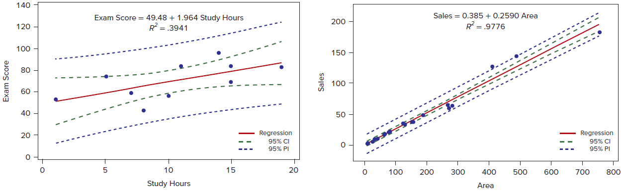
Confidence and Prediction Intervals For Y
LO 12-7
Confidence and prediction intervals for exam scores and retail sales.

Slide 52
Residual Tests
LO 12-8
Three Important Assumptions
Assumption 1: The errors are normally distributed.
Assumption 2: The errors have constant variance.
Assumption 3: The errors are independent.
While formal tests exist for identifying assumption violations, many analysts rely on simple visual tools to help them determine when an assumption has not been met and how serious the violation is.

Slide 53
Violation of Assumption 1: Non-Normal Errors
LO 12-8
Non-normality of errors is usually considered a mild violation because the regression parameter estimates b0 and b₁ and their variances remain unbiased and consistent.
The hypotheses are
H₀: Errors are normally distributed
H₁: Errors are not normally distributed
A simple way to check for non-normality is to make a histogram of the residuals.

Slide 54
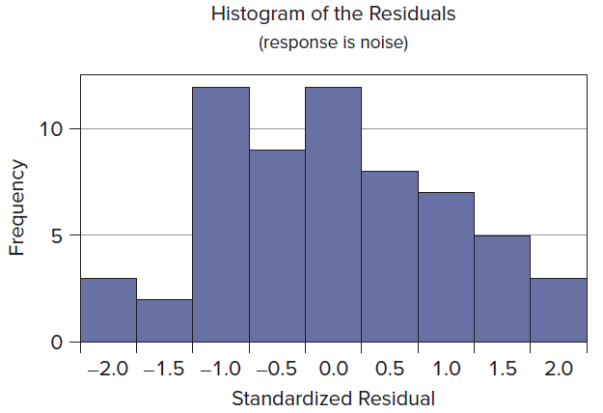
Violation of Assumption 1: Non-Normal Errors
LO 12-8
The Histogram shows a standardized residual histogram for Mini Case 12.3 (cockpit noise). There are no outliers and the histogram is roughly symmetric, albeit possibly platykurtic (i.e., flatter than normal).

Slide 55
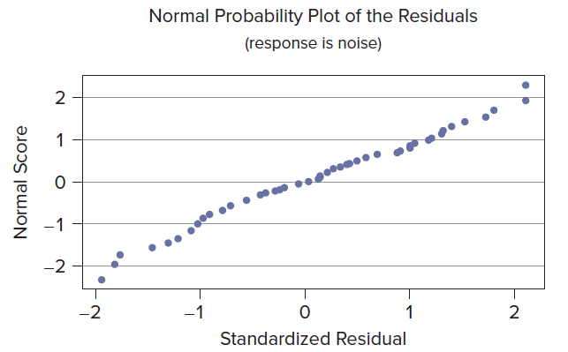
Violation of Assumption 1: Non-Normal Errors
LO 12-8
Another visual test for normality is the normal probability plot (also known as a quantile-quantile plot or simply q-q plot).
It plots observed cumulative data values against those that would be expected under the assumption of normality.
These residuals seem reasonably consistent with the null hypothesis of normality.

Slide 56
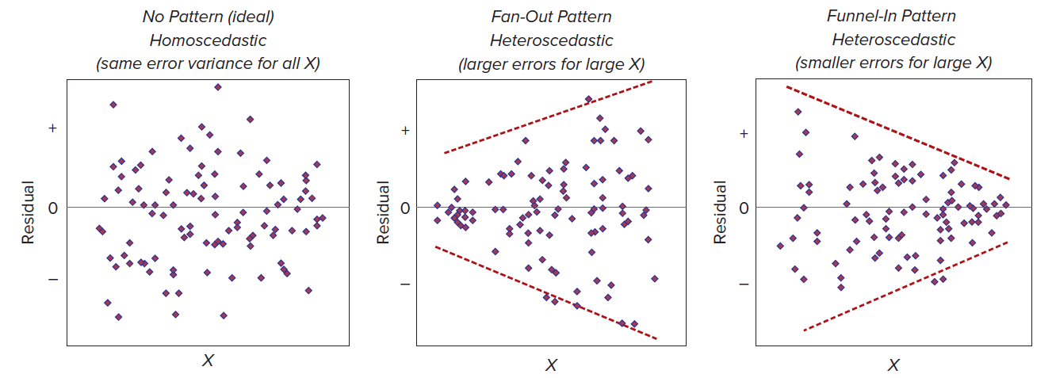
Violation of Assumption 2: Nonconstant Variance
LO 12-8
The regression should fit equally well for all values of X.
If the error magnitude is constant for all X, the errors are homoscedastic (the ideal condition).
If the error magnitudes increase or decrease as X changes, they are heteroscedastic.

Slide 57
Violation of Assumption 2: Nonconstant Variance
LO 12-8
Residual plots provide a fairly sensitive “eyeball test” for heteroscedasticity.
The residual plot is therefore considered an important tool in the statistician’s diagnostic kit.
The hypotheses are
H₀: Errors have constant variance (homoscedastic)
H₁: Errors have nonconstant variance (heteroscedastic)

Slide 58
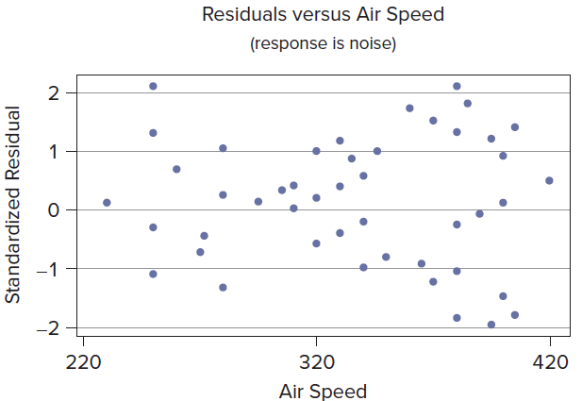
Violation of Assumption 2: Nonconstant Variance
LO 12-8
In this residual plot for Mini Case 12.3 (cockpit noise), the magnitude of the residuals does not increase or decrease as we look from left to right. A pattern like this is consistent with the null hypothesis of homoscedasticity (constant variance).

Slide 59
Violation of Assumption 3: Autocorrelated Errors
LO 12-8
Autocorrelation is a pattern of nonindependent errors, mainly found in time-series data.
When variable observations are collected in a specific order such as in a time series, it is possible that the errors e₁, e₂, . . . , e_{n} are related to each other.
Positive autocorrelation is indicated by runs of residuals with the same sign.
negative autocorrelation is indicated by runs of residuals with alternating signs.

Slide 60
Violation of Assumption 3: Autocorrelated Errors
LO 12-8
In the runs test, we count the number of sign reversals (i.e., how often does the residual plot cross the zero centerline?).
If the pattern is random, the number of sign changes should be approximately n/2.
Fewer than n/2 centerline crossings would suggest positive autocorrelation, while more than n/2 centerline crossings would suggest negative autocorrelation.

Slide 61
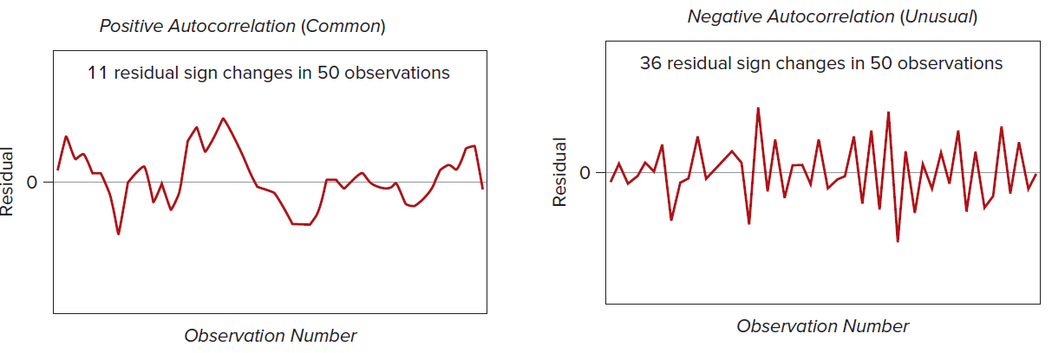
Violation of Assumption 3: Autocorrelated Errors
LO 12-8
For example, if n = 50, we would expect about 25 centerline crossings.
In the first illustration, there are only 11 crossings (positive autocorrelation), while in the second illustration there are 36 crossings (negative autocorrelation).

Slide 62
Unusual Observations
LO 12-9
In a regression, we look for observations that are unusual.
An observation could be unusual because its Y-value is poorly predicted by the regression model (unusual residual) or because its unusual X-value greatly affects the regression line (high leverage).
Tests for unusual residuals and high leverage are important diagnostic tools in evaluating the fitted regression.

Slide 63
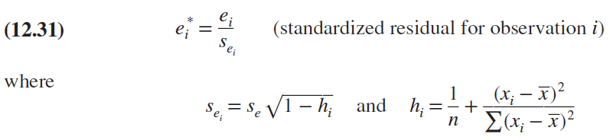
Unusual Residuals
LO 12-9
Because every regression may have different Y units (e.g., stock price in dollars, shipping time in days), it is helpful to standardize the residuals by dividing each residual, e_{i}, by its individual standard error, s_{ei}.
One can use Excel, Minitab, MegaStat or other software to compute standardized residuals.

Slide 64
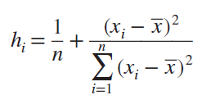
High Leverage
LO 12-10
A high leverage statistic indicates that the observation is far from the mean of X.
Such observations have great influence on the regression estimates because they are at the “end of the lever.”
The leverage for observation i is denoted h_{i} and is calculated as

Slide 65
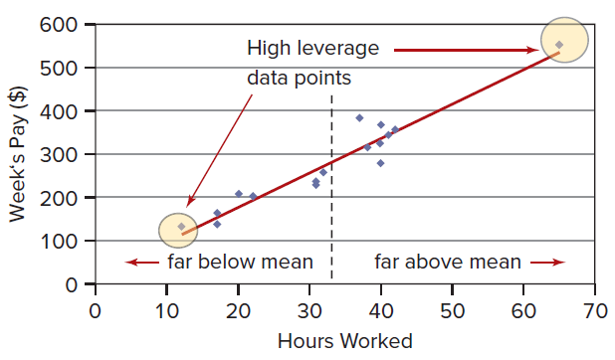
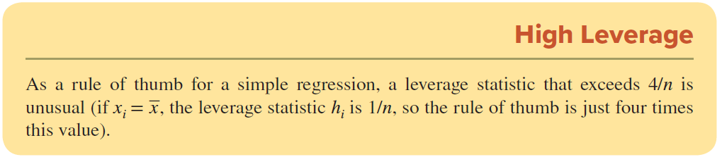
High Leverage
LO 12-10
One individual worked 65 hours, while the others worked between 12 and 42 hours. This individual will have a big effect on the slope estimate because he is so far above the mean of X.

Slide 66
Other Regression Problems
LO 12-11
Outliers may be caused by | To fix the problem
An error in recording data | Delete the observation(s)
Impossible data | Delete the data
An observation that has been influenced by an unspecified “lurking” variable that should have been controlled but wasn’t. | Formulate a multiple regression model that includes the lurking variable.

Slide 67
Other Regression Problems
LO 12-11
Model Misspecification
If a relevant predictor has been omitted, then the model is misspecified.
Instead of simple regression, you should use multiple regression.
Ill-Conditioned Data
Well-conditioned data values are of the same general order of magnitude.
Ill-conditioned data have unusually large or small data values and can cause loss of regression accuracy or awkward estimates.
Avoid mixing magnitudes by adjusting the magnitude of your data before running the regression.

Slide 68
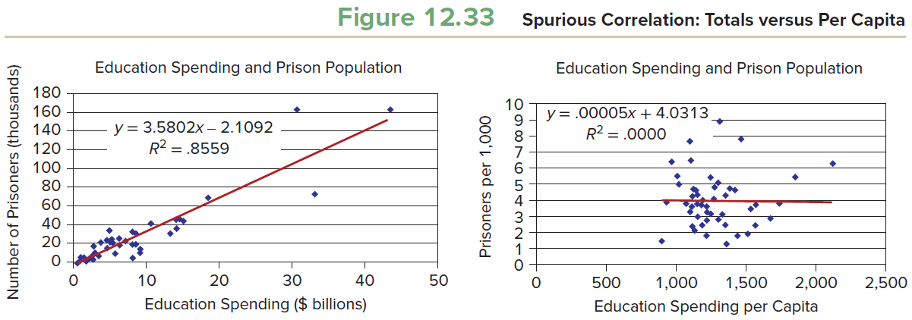
Other Regression Problems
LO 12-11
In a spurious correlation, two variables appear related because of the way they are defined.
For example, consider the hypothesis that a state’s spending on education is a linear function of its prison population. Such a hypothesis seems absurd, and we would expect the regression to be insignificant. But if the variables are defined as totals without adjusting for population, we will observe significant correlation.
This phenomenon is called the size effect or the problem of totals.

Slide 69
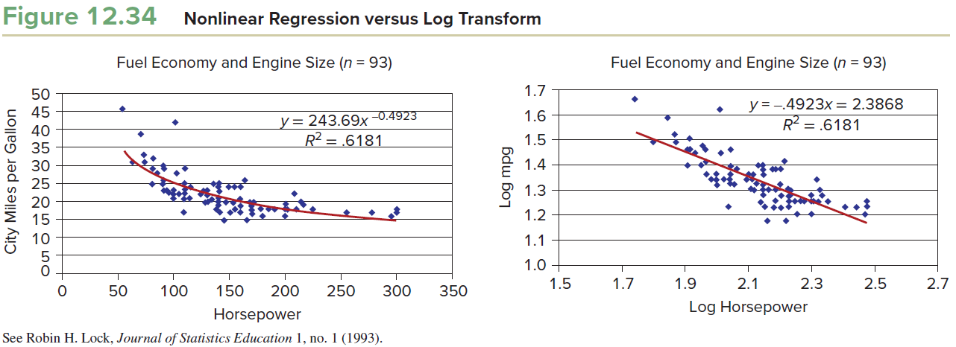
Other Regression Problems
LO 12-11
Model Form and Variable Transforms
Sometimes a nonlinear model is a better fit than a linear model.
Excel offers many model forms.
Variables may be transformed (e.g., logarithmic or exponential functions) in order to provide a better fit.
Log transformations reduce heteroscedasticity.
Nonlinear models may be difficult to interpret.

Slide 70
Binary Response Variable
LO 12-12
Sometimes we need to predict something that has only two possible values (a binary dependent variable).
For example, will a Chase bank customer use online banking (Y = 1) or not (Y = 0)? Will an Amazon customer make another purchase within the next six months (Y = 1) or not (Y = 0)?
Such research questions would seem to be candidates for regression modeling because we could define possible predictors such as a customer’s age, gender, length of time as an existing customer, or past transaction history.

Slide 71
Why Not Use Least Squares?
LO 12-12
Unfortunately, if you perform an ordinary least-squares regression with a binary response variable, there will be complications.
While the actual value of Y can only be 1 (if the event occurs) or 0 (if the event does not occur), the predicted value of Y should be a number between 0 and 1, denoting the probability of the event of interest.
Another issue is that your regression errors will violate the assumptions of homoscedasticity (constant variance) because as the predicted Y values vary from .50 (in either direction), the variance of the errors will decrease and approach zero.
Finally, significance tests assume normally distributed errors, which cannot be the case when Y has only two values (Y = 0 or Y = 1).
Therefore, tests for significance would be in doubt if you used linear regression with a binary response variable.

Slide 72

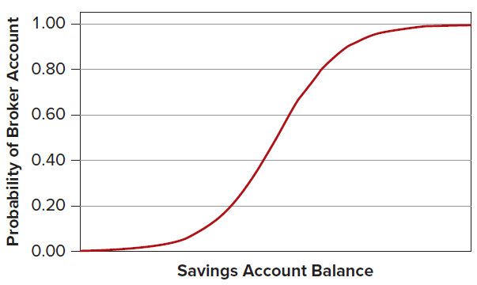
Why Not Use Least Squares?
LO 12-12
The solution is to choose logistic regression using the nonlinear regression model shown below. This equation predicts the probability that Y = 1 for any specified value of the independent variable. This model form ensures predictions within the range 0 < ŷ <1.
The logistic regression model has an S-shaped form, as illustrated. The logistic function approaches 1 as the value of the independent variable increases.

Slide 73
Estimating a Logistic Regression Model
LO 12-12
The underlying model is the Bernoulli (binary) distribution.
The event of interest either occurs (probability π) or does not occur (probability 1 – π).
Instead of the least squares method, we estimate the parameters using the method of maximum likelihood.
This method chooses values of the regression parameters that will maximize the probability of obtaining the observed sample data.

Slide 74
Estimating a Logistic Regression Model
LO 12-12
While easy to state in words, the computational procedure requires specialized software.
Any major statistical package will safely perform logistic regression (sometimes called logit for short) and will provide p-values for the estimated coefficients and predictions for Y.
An iterative process is required because there is no simple formula for the parameter estimates.
What is important at this stage of training is for you to recognize the need for a specialized tool when Y is a binary (0, 1) variable.

Slide 75
Chapter 12 Practice Problems

Slide 76
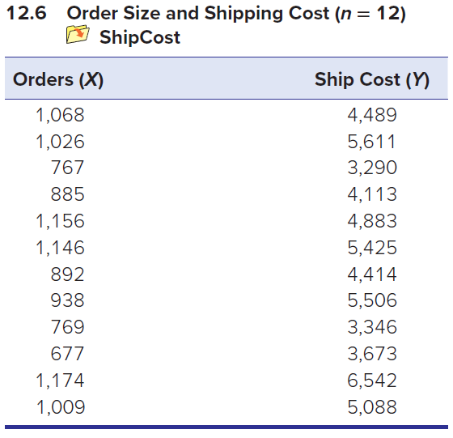
Question 6
LO 12-1
a. Make a scatter plot of the data. What does it suggest about the correlation between X and Y?
b. Use Excel to calculate the correlation coefficient.
c. Use Excel to find t.025 for a two-tailed test at α = .05.
d. Calculate the t test statistic.
e. Can you reject ρ = 0?

Slide 77
Question 9
LO 12-2
a. Interpret the slope of the fitted regression CarTheft = 1,667 − 35.3 MedianAge, where CarTheft is the number of car thefts per 100,000 people by state and MedianAge is the median age of the population.
b. What is the prediction for CarTheft if MedianAge is 40?
c. Would the intercept be meaningful if this regression applies to car thefts per 100,000 people by state?

Slide 78
Question 13
LO 12-3
The regression equation HomePrice = 51.3 + 2.61 Income was estimated from a sample of 34 cities in the eastern United States. Both variables are in thousands of dollars. HomePrice is the median selling price of homes in the city and Income is median family income for the city.
a. Interpret the slope.
b. Is the intercept meaningful? Explain.
c. Make a prediction of HomePrice when Income = 50 and also when Income = 100.
HomePrice1 file

Slide 79
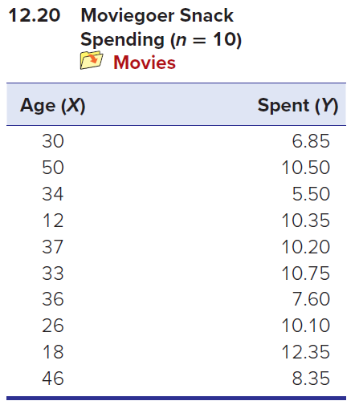
Question 20
LO 12-4
a. Use Excel to make a scatter plot of the data.
b. Select the data points, right-click, select Add Trendline, select the Options tab, and choose Display equation on chart and Display R-squared value on chart.
c. Interpret the fitted slope.
d. Is the intercept meaningful? Explain.
e. Interpret the R2.

Slide 80
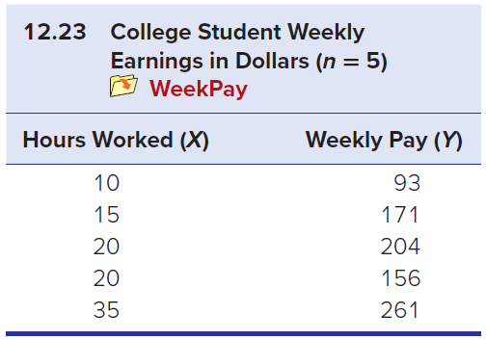
Question 23
LO 12-5
a. Perform a regression using MegaStat or Excel.
b. State the null and alternative hypotheses for a two-tailed test for a zero slope.
c. Report the p-value and the 95 percent confidence interval for the slope shown in the regression results.
d. Is the slope significantly different from zero? Explain your conclusion.

Slide 81
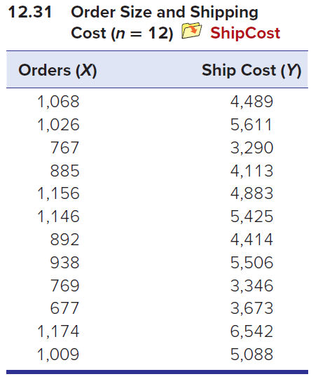
Question 31
LO 12-6
a. Use Excel’s Data Analysis > Regression (or MegaStat or Minitab) to obtain regression estimates.
b. Interpret the 95 percent confidence interval for the slope. Does it contain zero?
c. Interpret the t test for the slope and its p-value.
d. Interpret the F statistic.
e. Verify that the p-value for F is the same as for the slope’s t statistic, and show that t² = F.
f. Describe the fit of the regression.

Slide 82
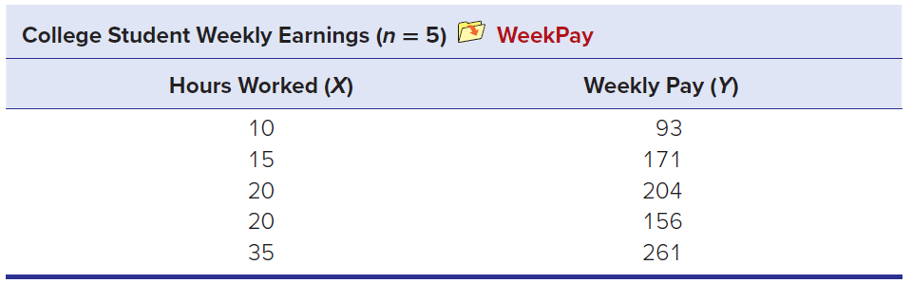
Question 32
LO 12-7
a. Calculate confidence and prediction intervals for Y using the following set of x values: 12, 17, 21, 25, and 30.
b. Report the 95 percent confidence interval and prediction interval for x = 17.
c. Calculate the 95 percent confidence interval for μy using the appropriate method from Chapter 8.
d. Compare the result from part (c) to the confidence interval you reported in part (b). How are they different?

Slide 83
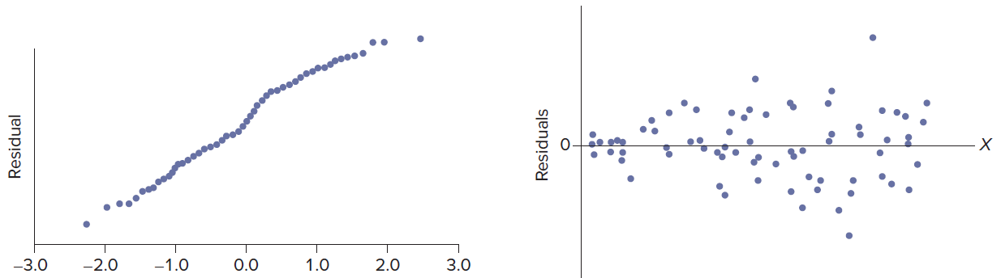
Question 35
LO 12-8
Review the two residual plots below. Do either of these show evidence that the regression error assumptions of normality and constant variation have been violated? Explain.

Slide 84
Question 39
LO 12-10
An estimated regression for a random sample of vehicles is MPG = 49.22 − 0.081 Horsepower, where MPG is miles per gallon and Horsepower is the engine’s horsepower. The standard error is s_{e} = 2.03. Suppose an engine has 200 horsepower and its actual (observed) fuel efficiency is MPG = 38.15.
a. Calculate the predicted MPG.
b. Calculate the residual.
c. Standardize the residual using s_{e}.
d. Is this engine an outlier?

Slide 85

Question 44
LO 12-12
A binary logistic regression was fitted using a sample of employees of a large corporation to investigate if the employee’s monthly salary (Salary) predicts whether (1) or not (0) the employee has a 401(k) retirement plan (401K). Use the fitted equation to predict the probability of a 401(k) plan for an employee whose monthly salary is
a. $3,000
b. $5,000
c. $8,000

Slide 86
Chapter 12 Analytics in Action

Slide 87


